Slide 1

DEPARTMENT OF COMPUTER SCIENCE & ENGINEERING
Title: Speech-Based Emotion , Age and Gender Detection with Speech-to-Text
BATCH ID : 23MPCS-D5
S. No | Roll. No | Student Name
1 | 23881A05R4 | V. Sai Prasaad
2 | 24885A0523 | Roopa Ramthapure
3 | 24885A0525 | Dhudukala Thapaswini
Guide Details
Dr. U. Sesadri
Associate Professor
Department of CSE
Vardhaman College of Engineering

Slide 2
Mini Project Review-2 Outlines
Main idea of the Project
Existing System Vs Proposed
Proposed Project Objectives
Proposed Project Outcomes
Software and Hardware Requirements
Process Model
Design Phase
Architectural Diagram [Modified]
[UML Diagrams or Data Flow Diagrams] and ER-Diagrams ; It should be detailed diagrams
Proposed Methods and Algorithms
Results
Conclusion

Slide 3
Main idea of the Project
The main idea of this project is to build an intelligent speech analysis system that can automatically identify human emotion, gender, and age group from speech signals and convert spoken audio into text form.
The system extracts various acoustic features from speech signals such as MFCC, chroma features, mel spectrogram, spectral contrast, pitch, and zero crossing rate. These features are used to train machine learning and deep learning models for accurate classification.
A CNN + BiLSTM deep learning model is used for emotion recognition, while XGBoost classifiers are used for gender and age prediction. Additionally, the system uses Google Speech Recognition API to convert speech into text.
The system can analyze any speech audio file and output:
Detected Emotion
Predicted Gender
Predicted Age Group
Converted Speech Text

Slide 4
Existing System Vs Proposed
Existing systems generally focus on only one task, such as:
Speech-to-text conversion
Emotion detection
Speaker recognition
Limitations of existing systems:
Most systems detect only emotion
Some systems detect only gender
Age prediction is rarely included
Speech-to-text is usually implemented separately
Lack of multi-task integrated speech analysis
DEPARTMENT OF CSE MINI PROJECT REVIEW-4

Slide 5
Proposed Project Objectives
To develop a speech analysis system capable of detecting human emotions from voice
signals
To classify the gender of a speaker using machine learning techniques.
To predict the age group of the speaker from speech features.
To convert speech audio into text using speech recognition techniques.
To integrate multiple speech analysis tasks into a single intelligent system.
To improve accuracy using advanced deep learning and machine learning models.
Develop a system to detect emotions from speech signals
Identify age group and gender using voice characteristics
Implement speech-to-text conversion for textual analysis
Combine audio and text features for improved accuracy
Use machine learning/deep learning models for classification
Ensure real-time processing and prediction
Design a user-friendly interface for easy interaction
Improve system performance using feature extraction techniques (MFCC, pitch, etc.)
Build a scalable and efficient model for practical applications
Enhance human-computer interaction through intelligent speech analysis

Slide 6
Proposed Project Outcomes
The developed system will be able to:
Identify 8 emotional states from speech.
Predict speaker gender (Male/Female).
Classify speaker age group (Young, Adult, Senior).
Convert speech audio into text format.
Provide an integrated system for speech-based human behavior analysis.
Applications include:
Human-computer interaction
Smart assistants
Healthcare monitoring
Customer service analytics
Emotion-aware AI systems

Slide 7
Software and Hardware Requirements
Software | Purpose
Google Colab | Model development and training
Python | Programming language
Librosa | Audio feature extraction
TensorFlow / Keras | Deep learning models
XGBoost | Machine learning classification
SpeechRecognition | Speech-to-text conversion
Scikit-learn | Data preprocessing and evaluation
Hardware | Specification
Processor | Intel i5 / i7 or equivalent
RAM | Minimum 8 GB
Storage | 256 GB or above
GPU | Optional (Google Colab GPU used)
Microphone | For recording speech

Slide 8
Process Model
The project follows a Machine Learning Development Lifecycle:
Dataset Collection
Data Preprocessing
Feature Extraction
Model Training
Model Evaluation
Prediction System Development
Result Analysis

Slide 9
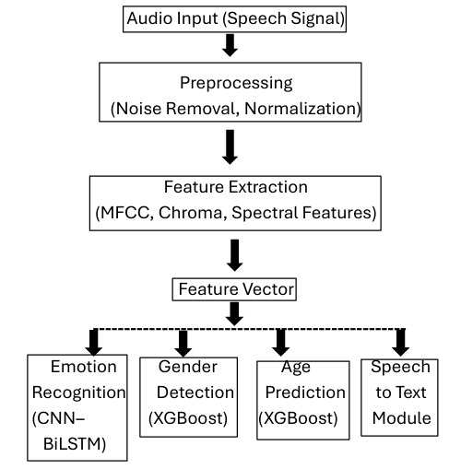
Architectural Diagram

Slide 10
PROPOSED METHOD AND ALGORITHMS
Feature Extraction
Extracted using Librosa library
Key features used:
MFCC, Delta & Delta-Delta MFCC
Chroma Features
Mel Spectrogram
Spectral Contrast
Zero Crossing Rate
Spectral Centroid & Rolloff
Pitch
These features capture acoustic and emotional characteristics of speech signals

Slide 11
PROPOSED METHOD AND ALGORITHMS
Emotion Detection Model
Model Used: CNN + BiLSTM
CNN: Extracts spatial features from audio signals
BiLSTM: Captures temporal dependencies in speech
Architecture:
Conv1D → Batch Normalization → Max Pooling → Dropout → BiLSTM → Dense → Softmax
Emotion Classes:
Neutral
Calm
Happy
Sad
Angry
Fearful
Disgust
Surprised

Slide 12
PROPOSED METHOD AND ALGORITHMS
Gender Classification Model
Algorithm: XGBoost
Advantages:
High accuracy
Efficient for structured data
Reduces overfitting
Output: Male / Female
Age Prediction Model
Algorithm: XGBoost (Multi-Class)
Age Groups:
Young
Adult
Senior

Slide 13
PROPOSED METHOD AND ALGORITHMS
Speech-to-Text Conversion
Library Used: SpeechRecognition
API: Google Speech Recognition API
Function:
Converts speech audio into text
Helps in understanding spoken content

Slide 14
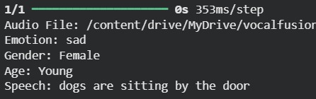
Results

Slide 15
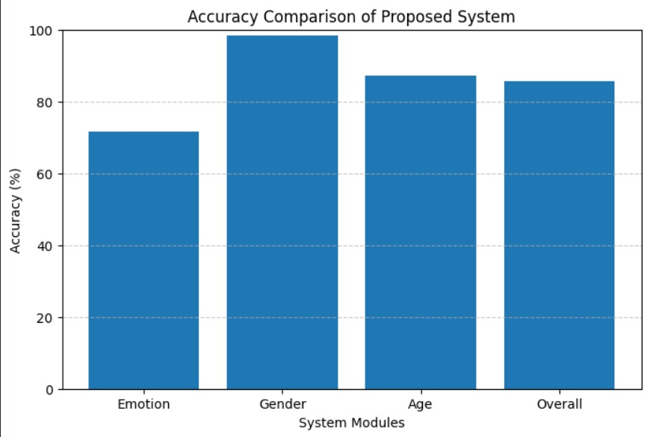
Results

Slide 16
Results Analysis
Accuracy Comparison of Proposed System
The graph shows the performance of different system modules
Emotion Detection: ~72% accuracy
Gender Detection: ~98% accuracy (highest performance)
Age Prediction: ~87% accuracy
Overall System Accuracy: ~86%
Key Observations
Gender detection performs best due to distinct voice features (pitch, frequency)
Age prediction shows good accuracy but slightly lower due to voice variability
Emotion detection has moderate accuracy because emotions can be similar
Overall system performance is high and reliable

Slide 17
Conclusion
This project successfully developed an intelligent speech analysis system capable of detecting emotion, gender, and age from speech signals while converting speech into text. By combining deep learning models (CNN + BiLSTM) and machine learning algorithms (XGBoost), the system achieves high accuracy in speech classification tasks. The proposed system demonstrates the potential of speech processing techniques for real-world applications such as human-computer interaction, emotion-aware AI systems, and smart voice assistants.
Model Performance
Uses CNN + BiLSTM for emotion detection
Uses XGBoost for gender and age prediction
Achieves high accuracy in classification tasks

Slide 18
Thank You

